Slide 1
Factor Timing
Progress report:
Data labelling
Feature selection
XGBoost model training

Slide 2
Summary:
Data labelling:
Trend scanning method.
Feature selection:
Identified broad categories of indicators with strong predictive power from literature.
Generated additional features (from Danial Page).
Feature importance – Mean Decreasing Accuracy:
Permutate individual features into and out of a classifier, and measure the change in OOS accuracy of model.
XGBoost classifier:
Combinatorial Purged Cross-Validation: Used for hyperparameter tunning.
Walk-forward validation: Use best parameters from CPCV and apply walk-forward validation for final predictions.

Slide 3
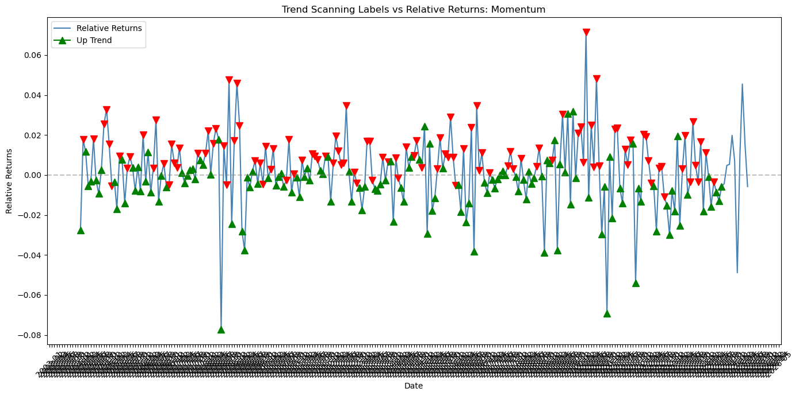
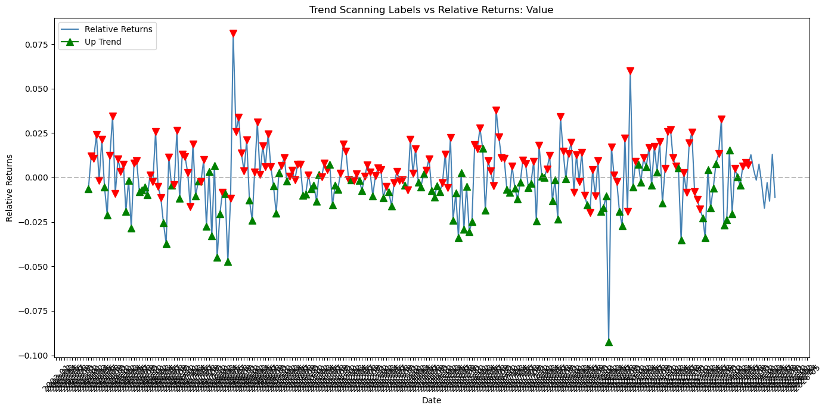
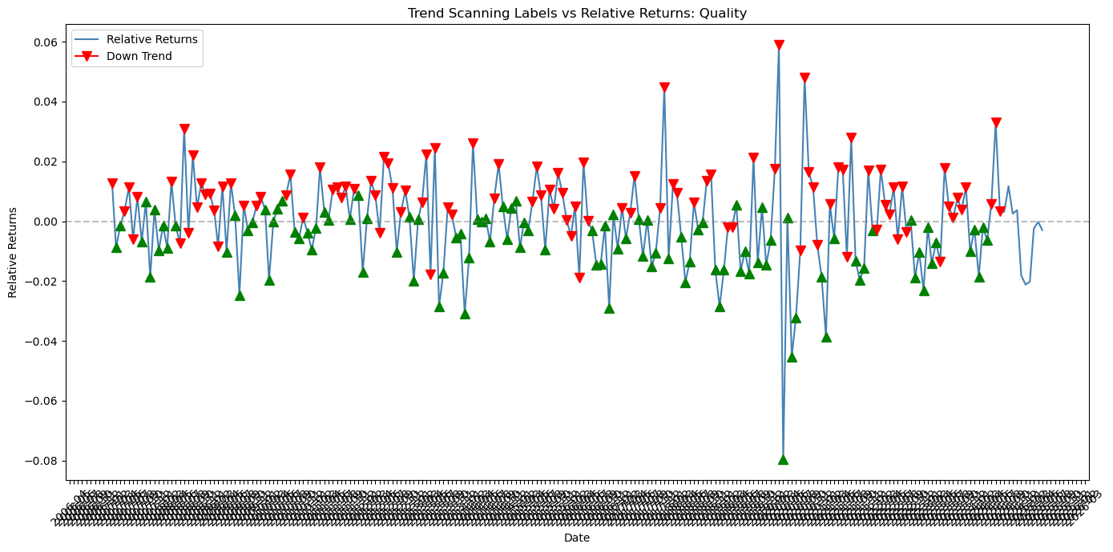
Data labelling:
Trend scanning technique:
Define the look-forward window, subdivide into expanding time windows.
Fit a linear regression between each sub-window, collect the regression slopes and t-stats.
Among all horizons, find the regression with the highest absolute t-stat.
Positive/negative slope = up/down trend.
Momentum factor relative returns labels
Value factor relative returns labels
Quality factor relative returns labels

Slide 4
Features Selection:
Factor predictors with strong predictive power under four different market scenarios
Liquidity and price trends proved to be a crucial driver of factor returns in both normal and market crises conditions.
Value and momentum indicators were robust across emerging and developed markets.
Size, volatility, sentiment, macroeconomic, and technical indicators showed varying degrees of predictive strength across the four different scenarios.

Slide 5
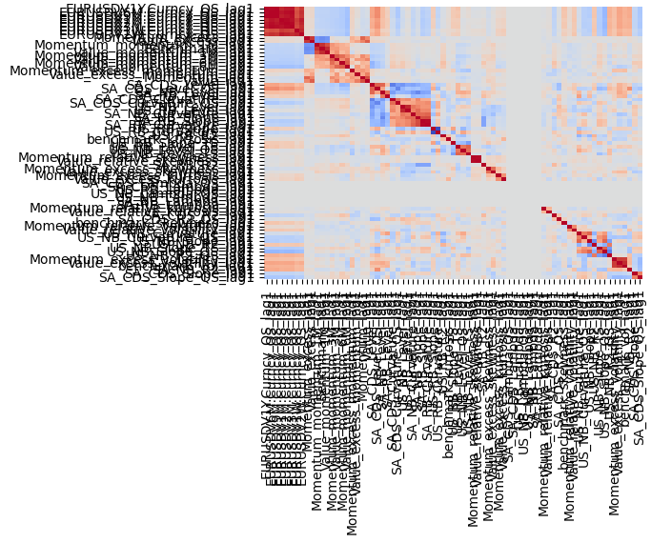
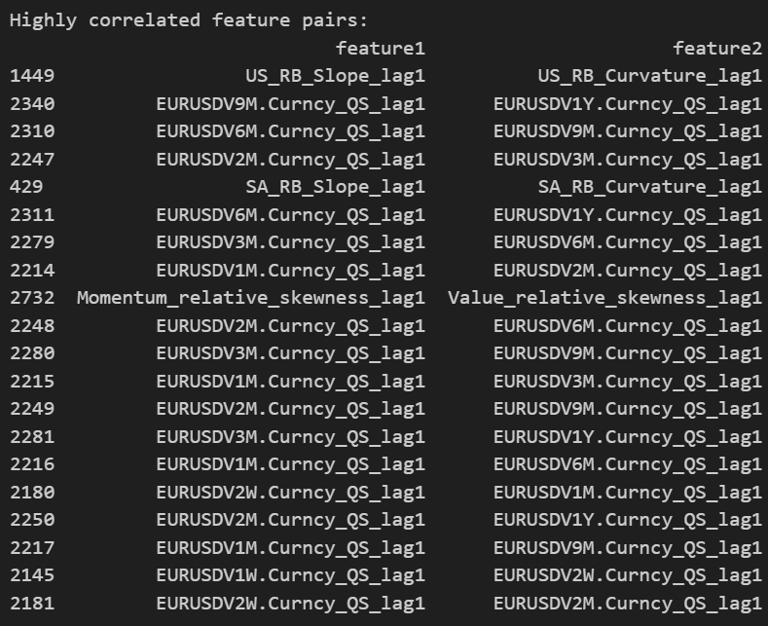
Feature Importance – Momentum Factor
Correlation heatmap of Top 50 features
Highly correlated features at correlation threshold = 0.75 (Top 20)
Investigate zero correlations

Slide 6
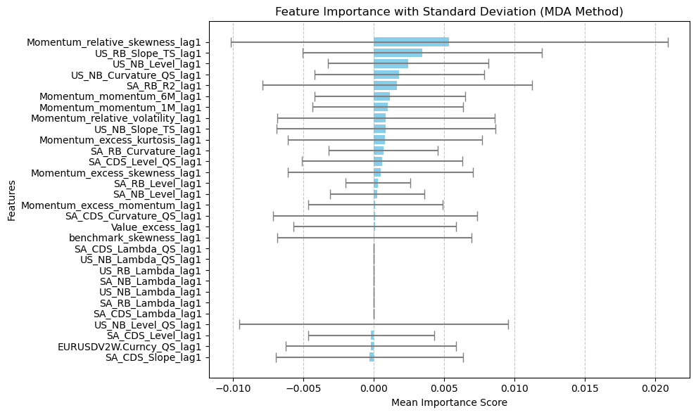
Feature Importance – Momentum Factor
Lopez de Prado – Mean Decrease Accuracy
Mean Importance - the average drop in out-of-sample performance when a feature is randomly permuted in the test set.
Methodology:
Fit a classifier – XGBoost (apply walk forward validation)
Derive OOS accuracy
Remove each column of the feature matrix, one at a time.
Derive OOS accuracy after each column’s removal.
The importance of the feature is measured by the loss in performance caused by its removal.
Caveat to method:
Subject to substitution effect – given two highly correlated features, shuffling one still allows the other to contribute to predictions.
Gives the false impression that both features are less important.

Slide 7
XGBoost Classifier:
Data ingestion
Combinatorial cross-validation
Walk-forward validations
Code efficiency
Import selected features.
Output best parameters.
CV splits = 10 (~24m each split), test splits = 2 (~48m), Purge gap =9m.
Use best parameters to make predictions.
Parameters tuned: learning rate, max_depth.
50 features and 239 months of data
Lag features by a month.
The CCV is very slow limiting the number of parameters one can tune.
Make 12 forward prediction.
Combinatorial Purged Cross-Validation:
Split data into smaller subsections.
Generate multiple unique combinations of training and testing sets.
Parameters are then optimized on these splits.
Aggregate the resulting parameter sets identify the most robust ones
Walk-forward validation:
Train on the training dataset and predict the first step in the test dataset.
Then add the real observation from the test set to the training dataset.
Refit the model, then have the model predict the next step in the test dataset.

Slide 8
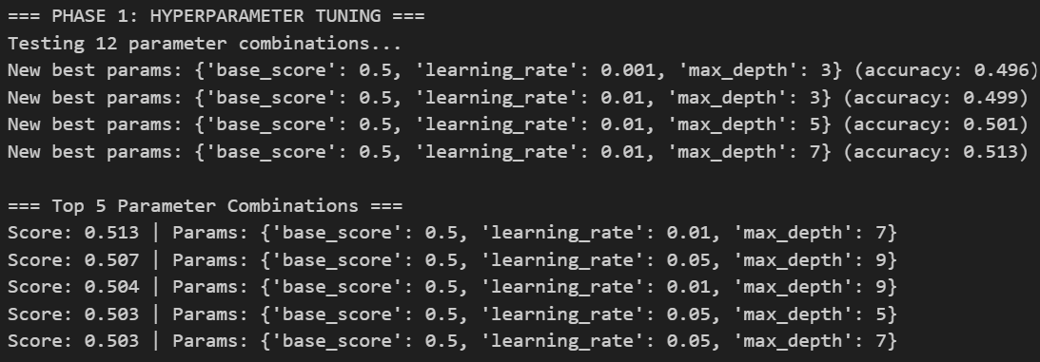
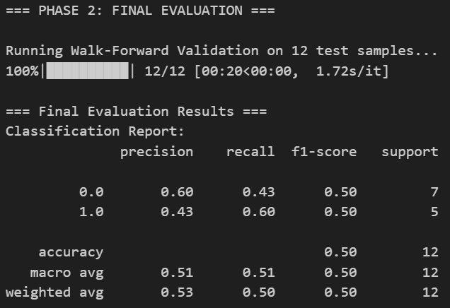
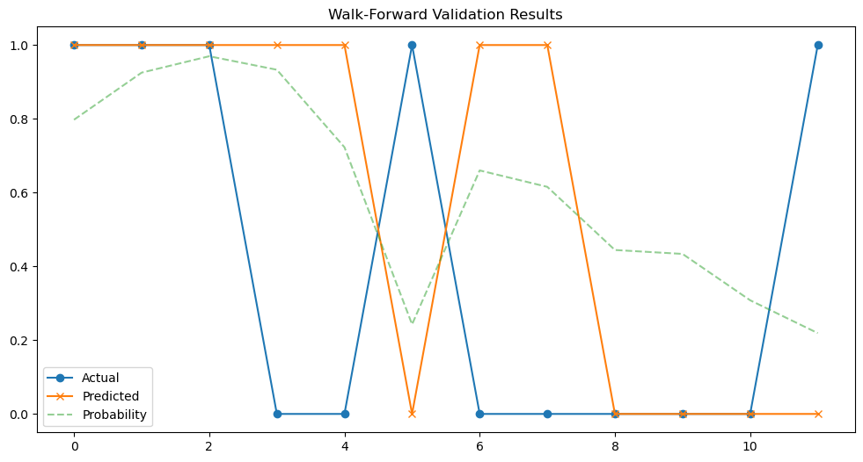
Preliminary Results – 12 month predictions
1. Best parameters from CPCV:
Model results are expected to improve once we:
Incorporate all features.
Apply formal data pre-processing.
2. Prediction results:
3. Visual of Actuals vs Predictions:

Slide 9
In progress:
Create a data preprocessing workflow.
Model training:
Logistic regression
GAM.

